Slide 1

DRUGS SIDE EFFECTS AND MEDICAL CONDITIONS

Slide 2

Table Of Contents
Introduction
Project Workflow Overview
Dataset Overview
Project Workflow Overview
Drug Recommendation System
Drug Recommendation for Health Issues
My Novelty
Future Scope
Conclusion

Slide 3
Introduction
Objective:
To analyze the side effects of various drugs and identify common medical conditions associated with them.
Why This Topic?
Healthcare relevance
Helps in better prescription decisions
Data-driven insight into side effects frequency

Slide 4
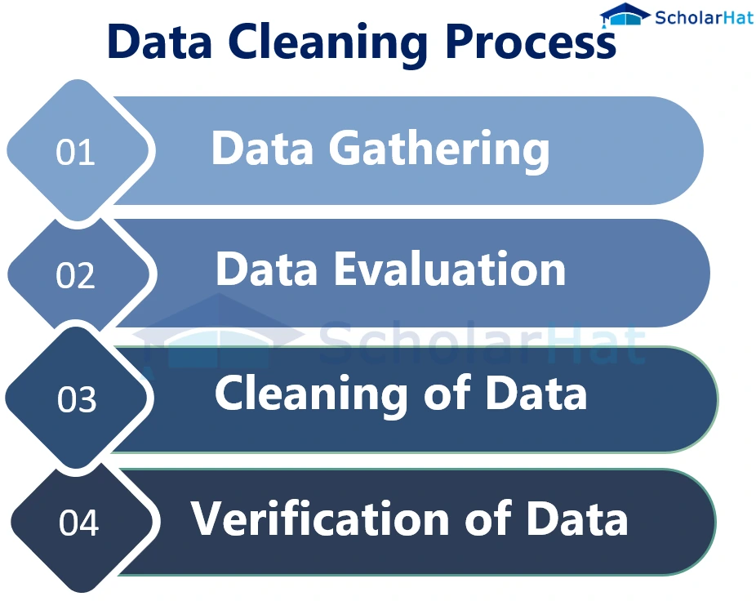
Project Workflow Overview
Data Cleaning & Preprocessing
Categorical Data Handling
Feature Engineering
Data Visualization & Analyzing Relationships
Drug Recommendation System
Drug Recommendation for Health Issues

Slide 5
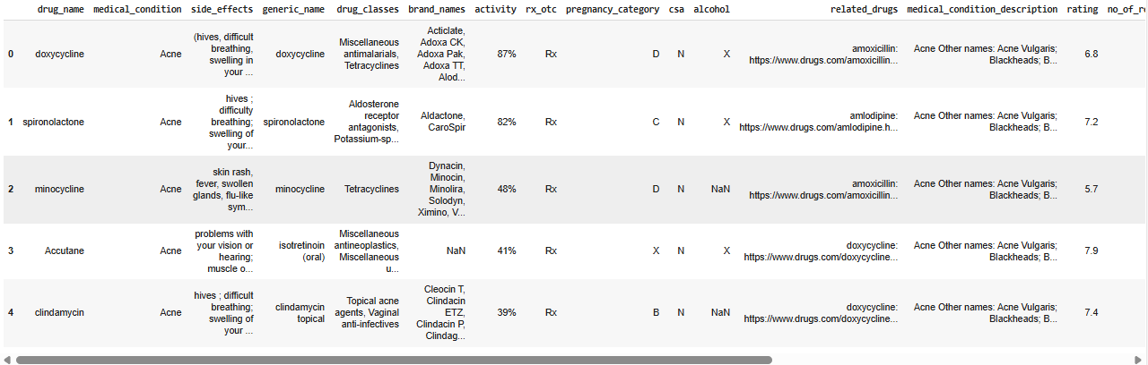
Dataset Overview
ontains drug names, associated side effects, medical conditions, and drug classes
Data includes multiple entries per drug, with side effects and classes stored as text lists
Requires cleaning, splitting, and feature extraction for analysis and modeling

Slide 6
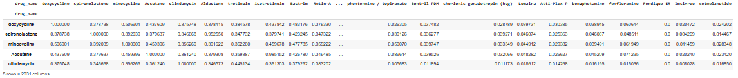
Data Cleaning & Preprocessing
Checked and handled missing values
Verified and transformed categorical values
Applied data cleaning using:
Splitting text by semicolons (;)
Stripping whitespaces
Converted structured lists into DataFrame format
Saved the cleaned data as a new CSV file for analysis
Outcome:
A clean, structured dataset ready for analysis and modeling.

Slide 7
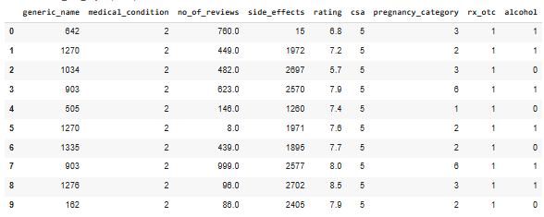
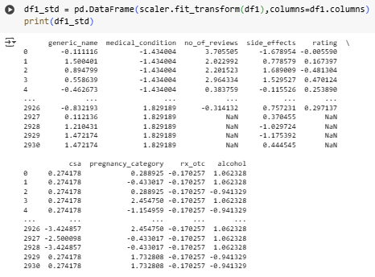
Categorical Data Handling
Converted categorical data into numerical format using encoding techniques
(Label encoding / one-hot encoding)
Extracted drug classes from raw text
Split using commas
Normalized and stored as separate columns
Purpose:
To make the dataset machine-learning ready and structurally analyzable.

Slide 8
Feature Engineering
Checked for specific values within text fields:
Side Effects
Medical Conditions
Drug Classes
Created Boolean columns like:
has_dizziness, has_hives, is_painkiller, etc.
Enabled filtering, grouping, and analysis based on critical indicators.

Slide 9
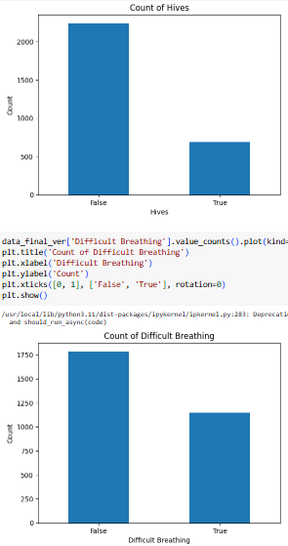
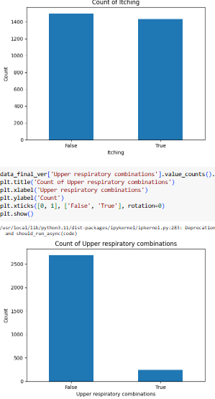
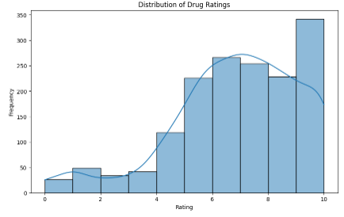
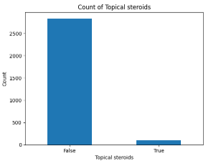
Data Visualization & Analyzing Relationships

Slide 10
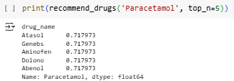
Drug Recommendation System
System 1: Focuses on treatment effectiveness
Name-Based Recommendation
This system recommend drugs based on exact or partial matches to the input drug name. It returns the top N similar drugs based on their similarity scores.
Input: Drug name (exact/partial)
Output: Top N similar drugs based on text similarity
Technique: String matching / similarity scoring
Purpose:
To help find alternative medications with similar purposes.

Slide 11
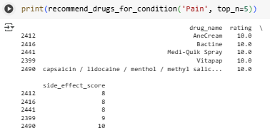
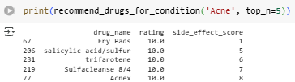
Drug Recommendation for Health Issues
System 2: Prioritizes minimizing side effects
Side-Effect Minimization:
This system focuses more on minimizing side effects while ensuring the drug is effective.
Input: Specific health issue / condition
Output: Drug recommendations that are effective but with fewer side effects
Approach: Focus on safety and minimal adverse reactions

Slide 12


My Novelty
Future Scope
Developed two customized drug recommendation systems:
One for finding similar drugs by name
One for minimizing side effects while treating a condition
Introduced Boolean feature engineering to analyze specific symptoms, drug classes, and conditions
Combined data cleaning, NLP, and recommendation logic in a healthcare dataset (a unique blend rarely explored at student level)
Integrate with real-time medical APIs (e.g., openFDA, DrugBank) for dynamic recommendations
Build a web-based interface or chatbot for easy user interaction
Apply machine learning to predict potential side effects for new drug-condition pairs
Expand the system to include drug interactions and contraindications

Slide 13
Conclusion
Successfully analyzed drug-related data to understand side effects and medical conditions
Built two practical drug recommendation systems:
One focused on effectiveness (similar drugs)
One focused on safety (minimal side effects)
Demonstrated the power of data-driven decision-making in healthcare
This project bridges the gap between data science and real-world medical needs, with potential for further development into a clinical support tool

Slide 14
Thank You

